Slide 1
Digital Portfolio
STUDENT NAME:AKASH R
REGISTER NO AND NMID: 24132011802521004 & asanm20124132011802521004
DEPARTMENT: BSC COMPUTER SCIENCE
COLLEGE: AAGAC

Slide 2
PROJECT TITLE :
PERSONAL PORTFOLIO WEBSITE

Slide 3


AGENDA
Problem Statement
Project Overview
End Users
Tools and Technologies
Portfolio design and Layout
Features and Functionality
Results and GitHub Link
Screenshots
9.Conclusion
3/21/2024 Annual Review

Slide 4

PROBLEM STATEMENT
Fresh graduates and students often struggle to present their skills and achievements in a professional manner. Traditional resumes are static and don’t showcase projects effectively. There is a need for an online platform where individuals can display their resume, projects, and achievements in an attractive way.

Slide 5

PROJECT OVERVIEW
This project is a personal portfolio website designed to present a resume, skills, and projects in a clear and professional format. It allows visitors to view personal details, academic qualifications, and project work. The website is built using HTML and CSS and hosted on GitHub Pages for easy access.
---

Slide 6

WHO ARE THE END USERS?
*Students who want to showcase their resume online.
*Fresh graduates applying for jobs
*Professionals who need a digital portfolio.
*Recruiters and employers searching for candidate details.

Slide 7

TOOLS AND TECHNIQUES
*HTML – for webpage structure.
*CSS – for styling and layout.
*JavaScript – (if added) for interactivity.
*GitHub Pages – for hosting the website.

Slide 8
POTFOLIO DESIGN AND LAYOUT
The portfolio website is divided into multiple sections for easy navigation:
*Home Page – Brief introduction and welcome message.
*About Section – Personal details and educational background.
*Resume Section – Academic qualifications and skills.
*Projects Section – Showcase of completed projects with links/screenshots.
*Contact Section – Contact details for communication.
The design follows a clean and professional layout with simple colors and a user-friendly interface.
8

Slide 9
FEATURES AND FUNCTIONALITY
*Simple and responsive design.
*Resume details displayed clearly.
*Project showcase with screenshots and links.
*Easy navigation with multiple sections (Home, About, Projects, Contact).
*Hosted online with a shareable GitHub link.
---

Slide 10

RESULTS AND GITHUB LINK
*The portfolio website was successfully developed and hosted using GitHub Pages.
*It displays resume details, skills, and projects in a structured format.
*The design is simple, user-friendly, and responsive.
👉 Live Link: https://akashrajenthiran73-boop.github.io/Akash-TNSDC--FDW-DP/
3/21/2024 Annual Review
10

Slide 11
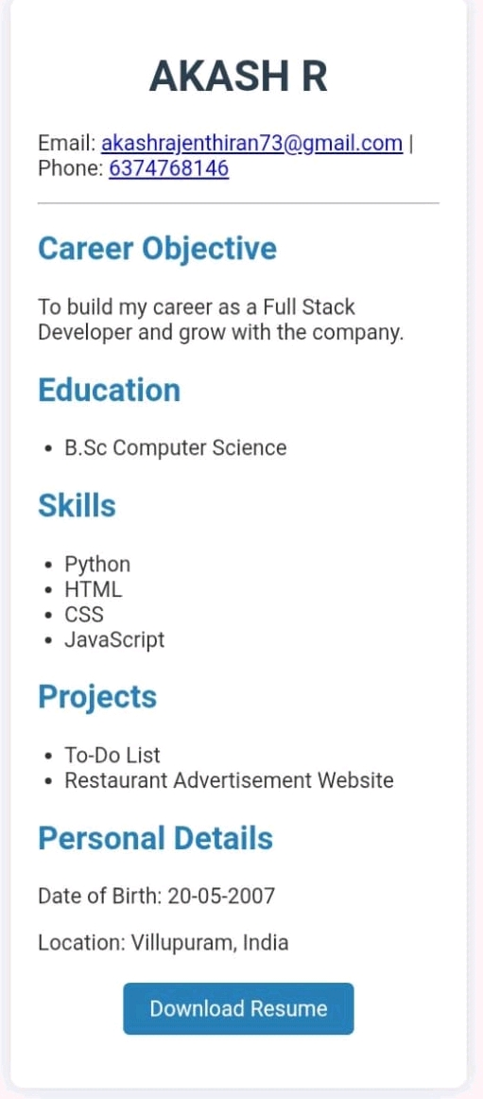
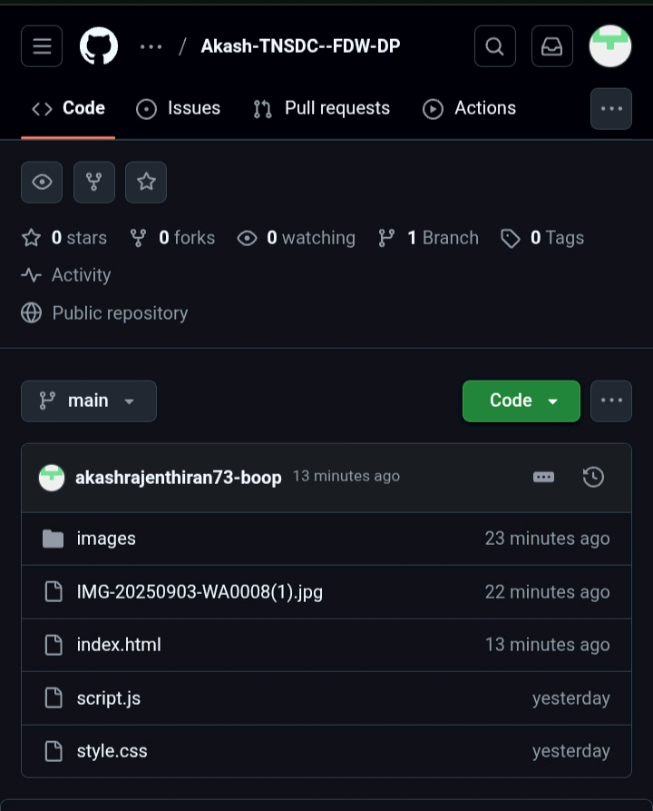
SCREENSHOTS

Slide 12
CONCLUSION
*The project successfully demonstrated the creation of a personal portfolio website.
*It provides a structured and attractive way to showcase resume, skills, and projects.
*The website is simple, user-friendly, and accessible online through GitHub Pages.
*This project improved my knowledge of web development and gave me hands-on experience with HTML, CSS, and hosting.
---
11

